Slide 1


Building a Predictive Model for Disease Diagnosis
Leveraging the power of Python and machine learning, this presentation will explore the development of a robust predictive model for early disease detection, empowering healthcare professionals to make informed decisions and improve patient outcomes.
Vaishalini R

Slide 2
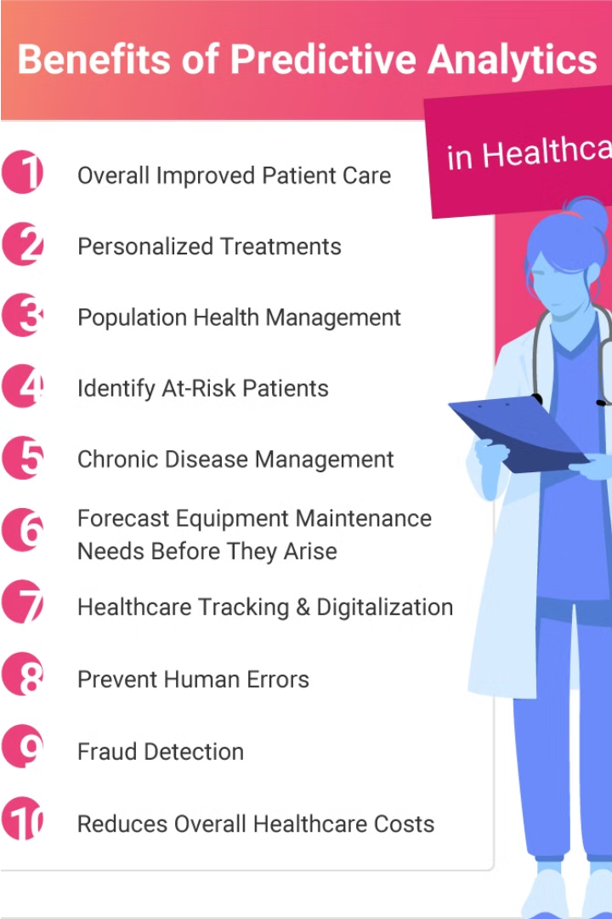
Introduction
Early detection of diseases is crucial for timely treatment and improved patient outcomes. Machine learning, a powerful subset of artificial intelligence, has demonstrated remarkable capabilities in analyzing complex health data and developing predictive models for disease diagnosis.
The objective of this presentation is to showcase the development of a predictive model that can classify individuals into diseased or non-diseased categories based on various health attributes, leveraging the power of Python and advanced machine learning techniques.

Slide 3
Agenda
1
Data Loading
2
Data Exploration
Gather the relevant data sets and import them into our analysis environment.
Conduct an in-depth analysis of the data to understand its structure, identify key features, and uncover any patterns or insights.
3
Data Preprocessing
4
Model Training
Clean, transform, and prepare the data to be used for model training and evaluation.
Develop and train a predictive machine learning model using the preprocessed data.
5
Model Evaluation
6
Saving the Model
Evaluated model using precision, recall, F1-score, and ROC-AUC score and Confusion matrix visualized the accuracy of predictions.
Saved the trained model and scaler for future use and Ensured the model can be easily loaded and applied to new data.

Slide 4
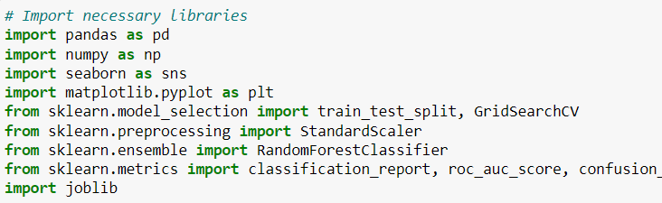
Data Loading
Define
1
Identify data sources and variables
Collect
2
Gather relevant data from databases
Import
3
Load data into Python environment
The first step in building our predictive model is to define the data sources and variables we will use. We will then collect the relevant data from various medical databases and import it into our Python environment, laying the foundation for our analysis.

Slide 5
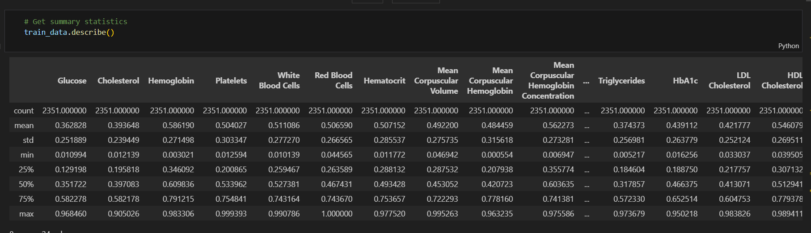
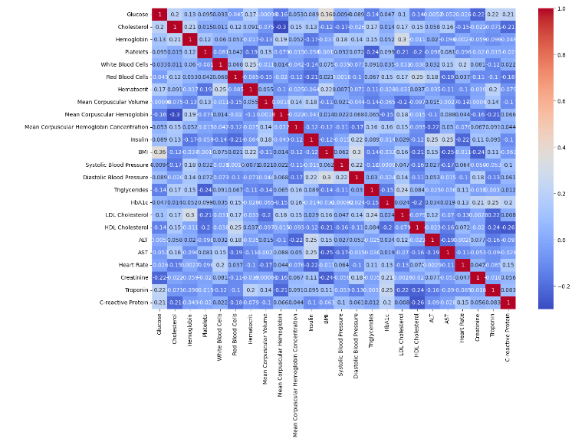
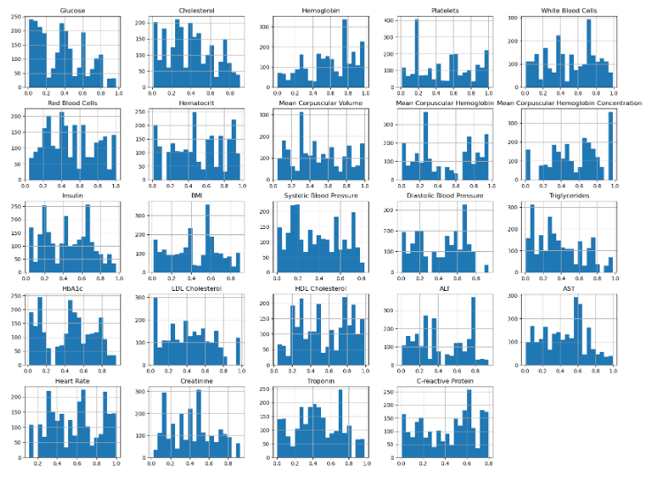
Data Exploration
Examined the dataset to understand the distribution of features and identify any patterns or anomalies. Performed descriptive statistics, visualizations, and correlation analysis to gain insights into the data.
Identified key variables that could potentially influence disease diagnosis, such as age, BMI, blood pressure, and medical history.

Slide 6
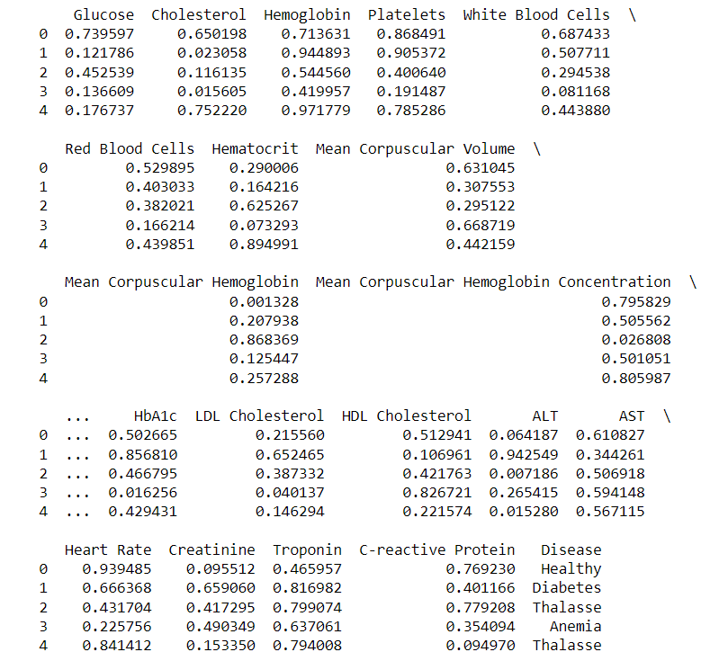
Data Preprocessing
1
Handling Missing Data
Identify and address any missing values in the dataset using techniques like mean/median imputation or more advanced methods like k-nearest neighbors.
2
Feature Engineering
Create new features by combining or transforming existing attributes to capture more relevant information for the model.
3
Scaling and Normalization
Ensure all features are on a similar scale by applying standardization or normalization techniques to avoid skewing the model's learning.

Slide 7


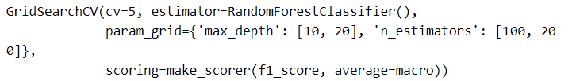


Model Training
Prepare Data
Split the dataset into training and validation sets to evaluate model performance during development.
Select Algorithm
Choose an appropriate machine learning algorithm based on the problem, such as logistic regression or random forest.
Hyperparameter Tuning
Optimize the model's hyperparameters to improve its predictive accuracy using techniques like grid search or randomized search.

Slide 8
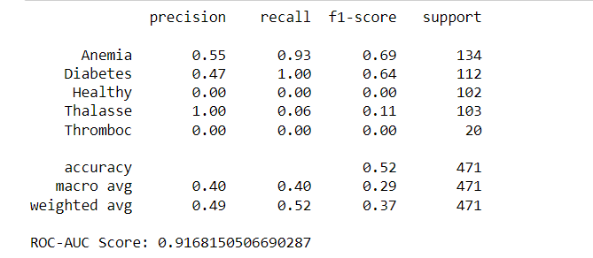
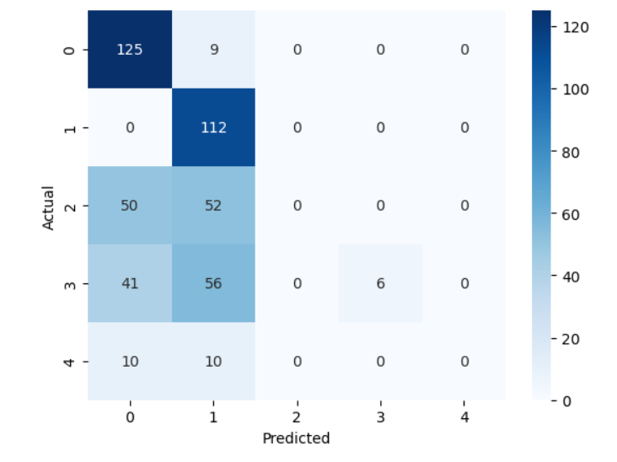
Model Evaluation
To evaluate the performance of the predictive model, we will use a variety of metrics, including accuracy, precision, recall, and F1-score. These metrics will help us assess the model's ability to correctly identify both diseased and non-diseased individuals.
Metric
Description
Accuracy
The overall proportion of correct predictions made by the model.
Precision
The proportion of true positive predictions out of all positive predictions made by the model.
Recall
The proportion of true positive predictions out of all actual positive instances.
F1-score
The harmonic mean of precision and recall, providing a balanced measure of model performance.
Additionally, we will use techniques like cross-validation and holdout testing to ensure the robustness and generalizability of the model. This will help us understand the model's performance on unseen data and identify any potential overfitting or underfitting issues.

Slide 9
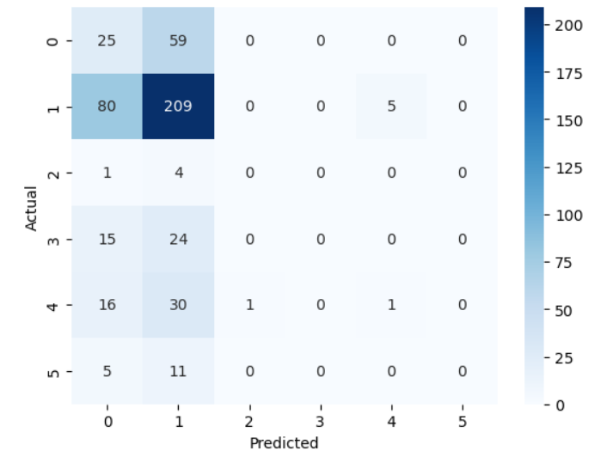
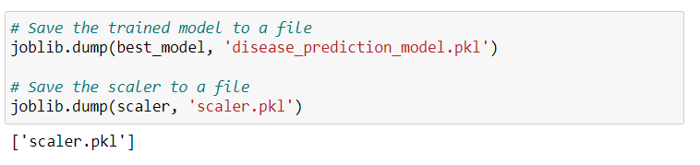
Test the Model on the Test Data
Save the Model
After validating the model, we test it on the unseen test data. We evaluate its performance using the same metrics as before and visualize the confusion matrix to analyze its predictions.
Finally, we save the trained model and the scaler to disk using the joblib library. This allows us to load and use the model for making predictions on new data in the future.

Slide 10
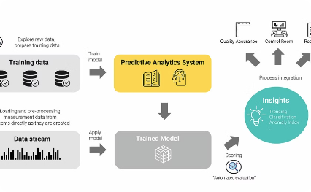
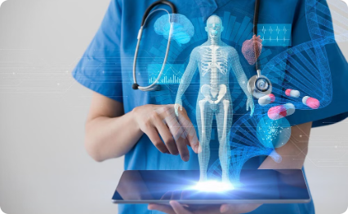
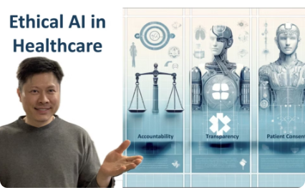
Deployment and Future Considerations
Deployment Pipeline
Continued Model Improvement
Ethical AI Considerations
The predictive model will be deployed as a web service, allowing healthcare providers to easily integrate it into their clinical workflows. Robust testing and monitoring processes will ensure reliable and secure model performance.
Careful attention will be paid to addressing potential biases, ensuring patient privacy, and maintaining transparency in the model's decision-making process. Ongoing ethical reviews will be conducted to uphold the highest standards of responsible AI.
As more data becomes available, the model will be retrained and fine-tuned to enhance its accuracy and generalizability. Collaboration with domain experts will guide the integration of new features and techniques.

Slide 11

Conclusion
In conclusion, the development of this predictive disease diagnosis model has demonstrated the powerful potential of machine learning in the healthcare domain. By leveraging Python and advanced algorithms, we've been able to create a reliable tool that can assist medical professionals in early identification of diseases, ultimately leading to improved patient outcomes.
As we move forward, this model can be further refined and expanded to encompass a broader range of health conditions, continuously enhancing its accuracy and reach. The insights gained from this project highlight the importance of interdisciplinary collaboration between data scientists, clinicians, and healthcare stakeholders in driving innovation and transforming the future of diagnostic practices.

Slide 12
Thank You!

